Slide 1
Genome browsers introduction
Part 3: IGV browser
Philippe Gautier (a.k.a. Gogo)
Bioinformatics Service
24/09/2021

Slide 2
Broad comparison
Ensembl and UCSC: access to all publicly available data
Ensembl and UCSC: limited possibility to upload your own data
IGV: suitable to browse your own data
IGV: particularly useful for Next gen sequencing data or any large dataset

Slide 3

Introduction to the Integrative Genomics Viewer (IGV)
Jim Robinson Helga Thorvaldsdóttir
BroadE Workshop, April 2017

Slide 4
Workshop materials online
Data for workshop exercises:
www.igv.org/workshops/BroadApril2017/igvData.zip
Workshop exercise handouts:
www.igv.org/workshops/BroadApril2017/IGV_Exercises.pdf
Workshop slides:
www.igv.org/workshops/BroadApril2017/IGV_SlideDeck.pdf

Slide 5
IGV
Integrative
Genomics
Viewer

Slide 6
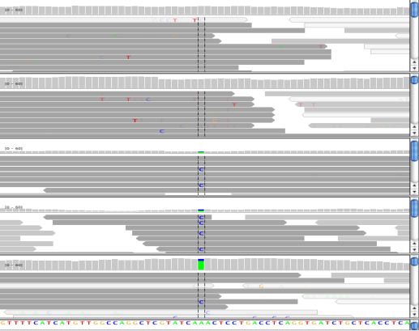
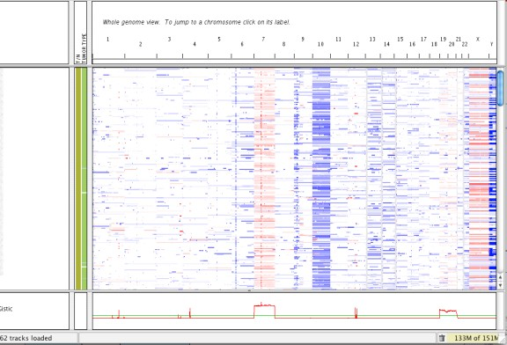
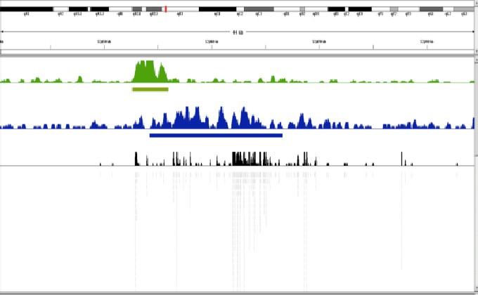
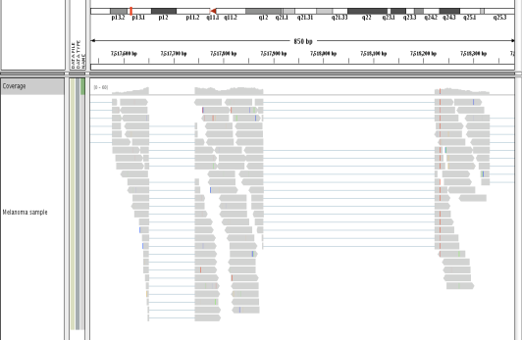
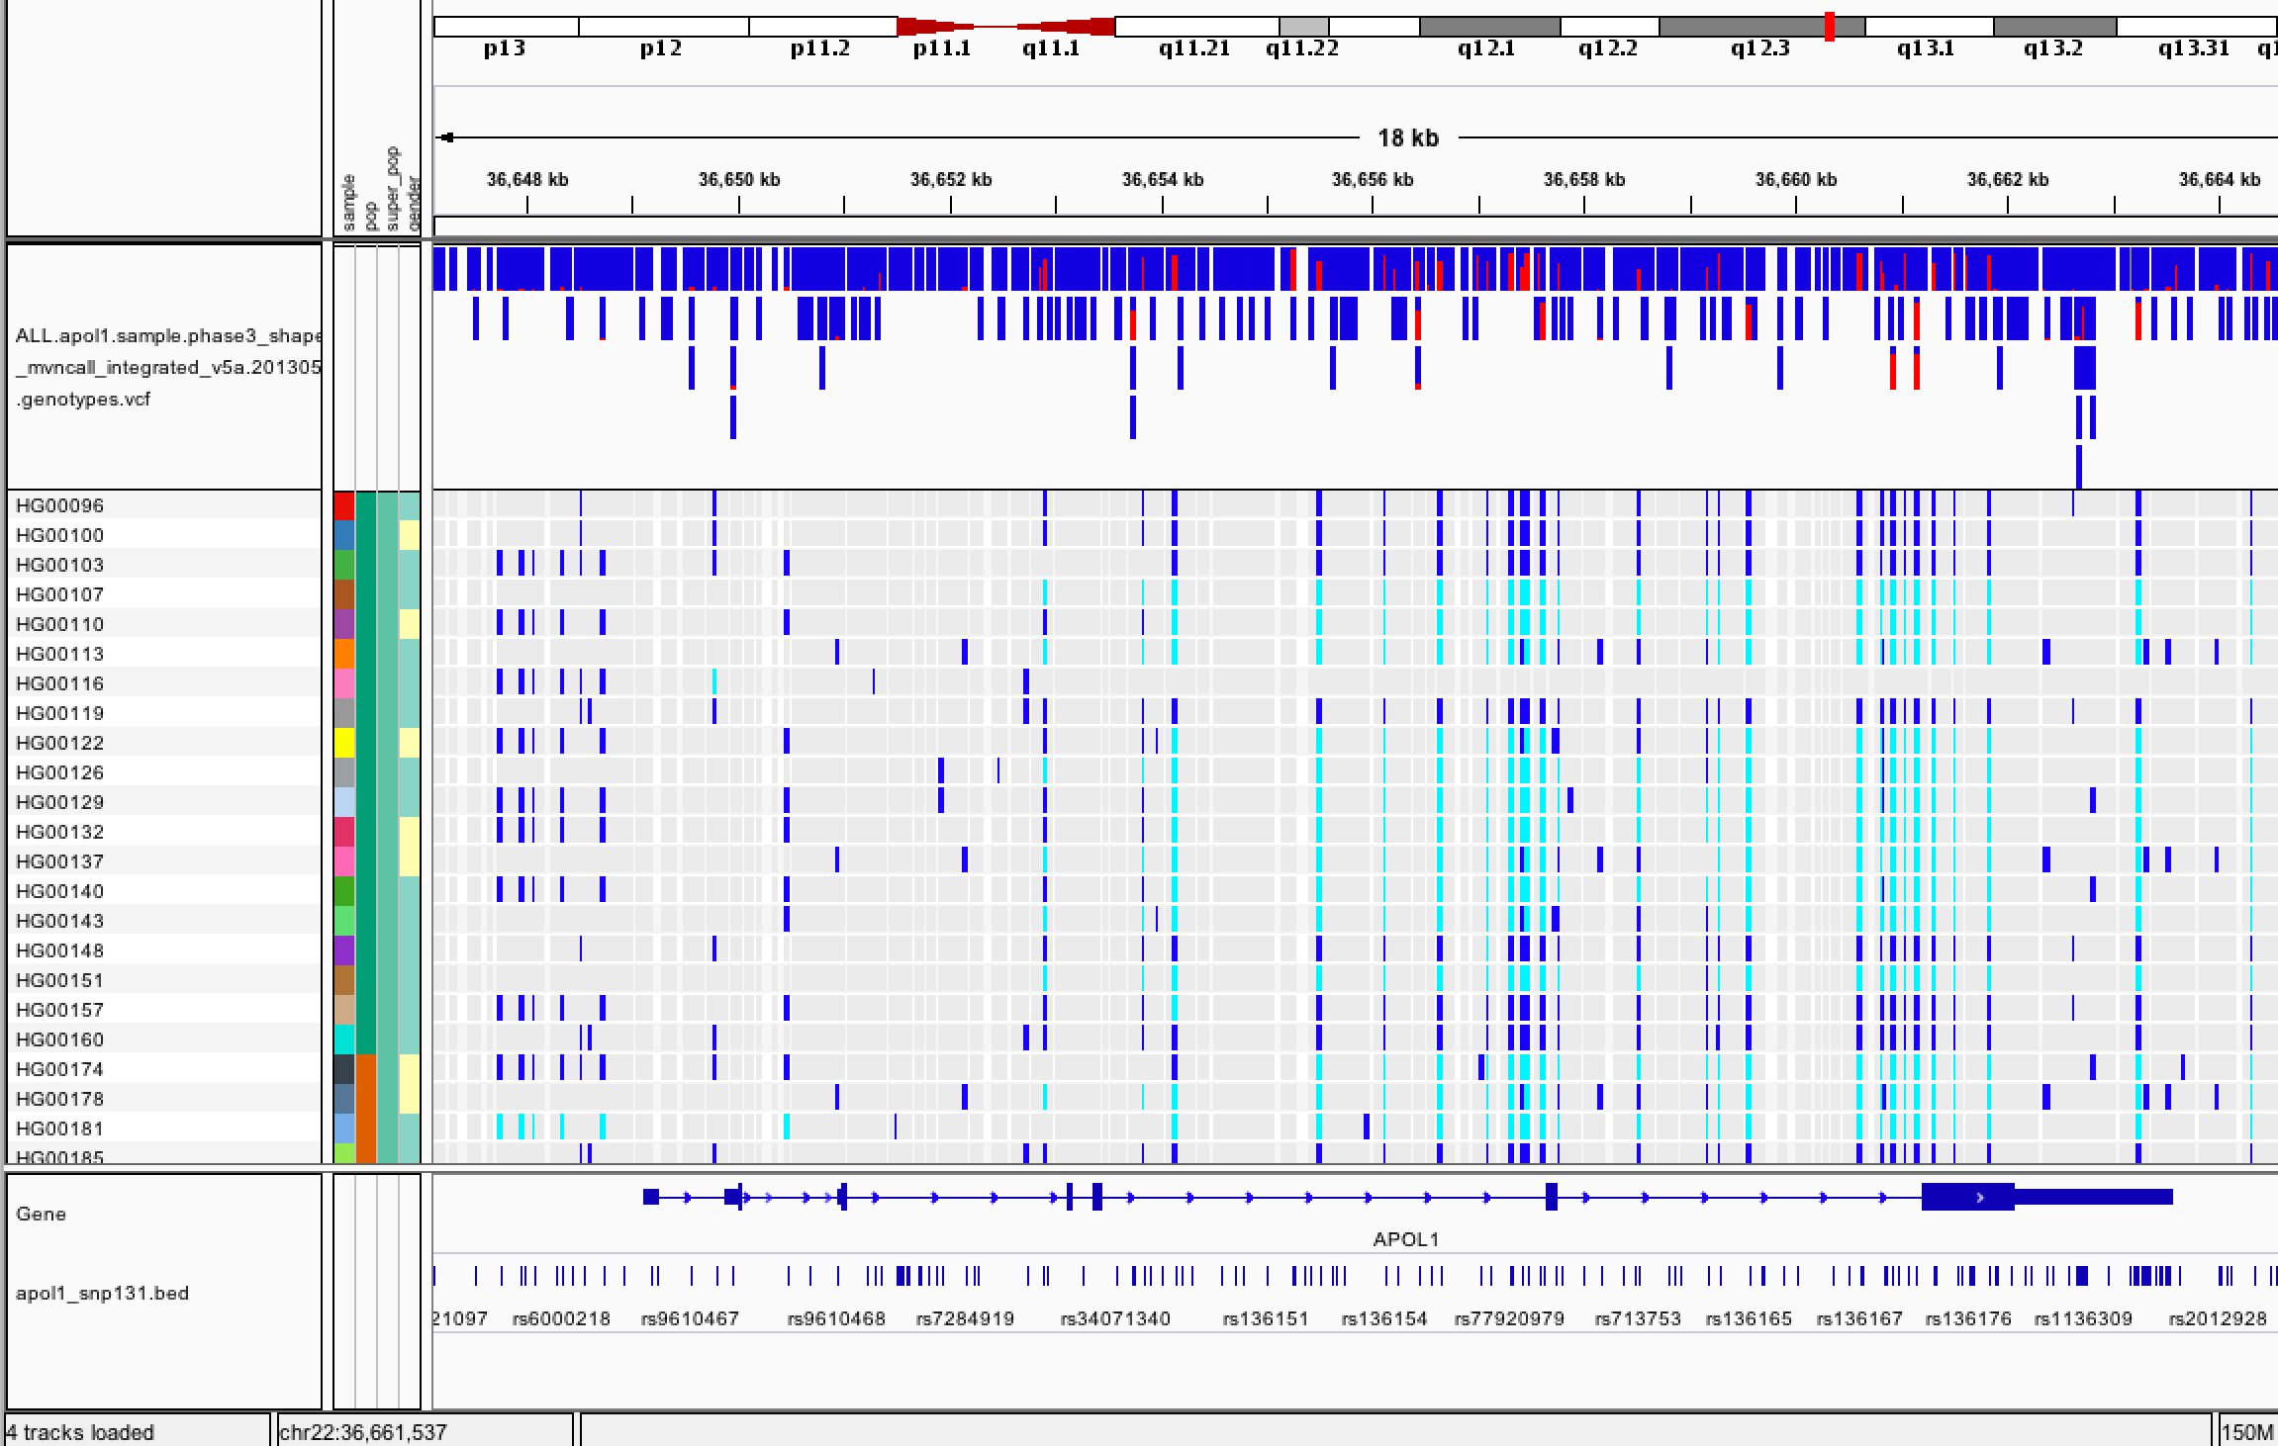
NGS alignments
Epigenomics
Copy number
RNA-seq
Variants and genotypes

Slide 7
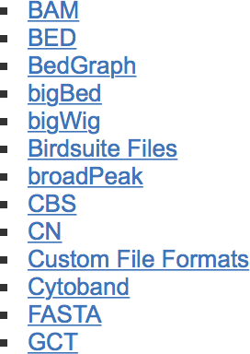
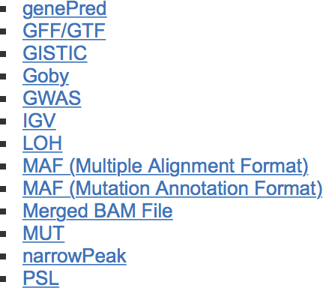
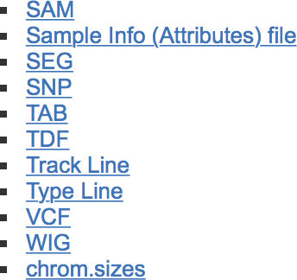
IGV supports many different file formats
For more info see: www.broadinstitute.org/igv/FileFormats

Slide 8
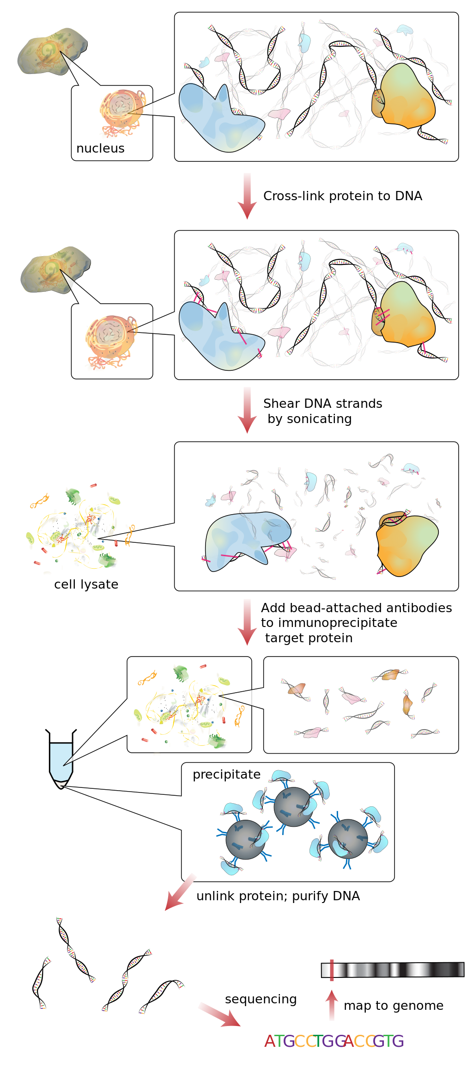
Reminder: ChIP-seq
Epigenomics
Coverage calculation
wig/bigwig files

Slide 9
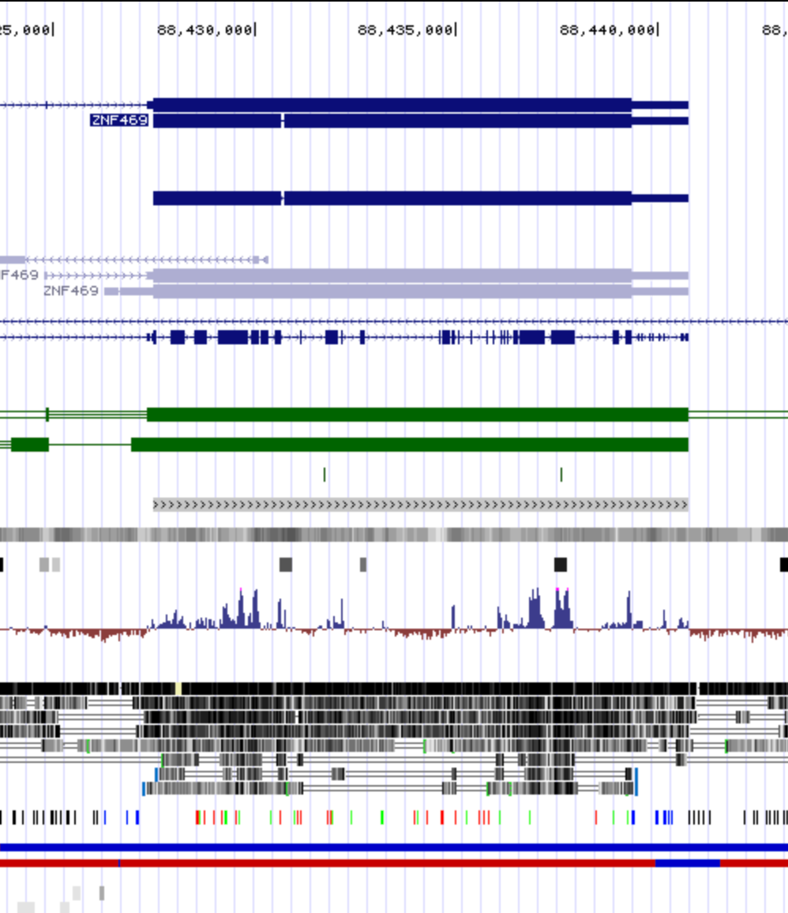
Wiggle (WIG)/Bigwig
For graphical display of dense, continuous data , like GC content, conservation score, etc
variableStep chrom=chr2
300701 12.5
300702 12.5
300703 12.5
300704 12.5
300705 12.5
is equivalent to:
variableStep chrom=chr2 span=5
300701 12.5
fixedStep chrom=chr3 start=400601 step=100
11
22
33
displays the values 11, 22, and 33 as single-base regions on chromosome 3 at positions 400601, 400701, and 400801, respectively. Adding span=5 to the declaration line:
fixedStep chrom=chr3 start=400601 step=100 span=5
11
22
33
causes the values 11, 22, and 33 to be displayed as 5-base regions on chromosome 3 at positions 400601-400605, 400701-400705, and 400801-400805, respectively.

Slide 10
Using IGV – The Basics

Slide 11
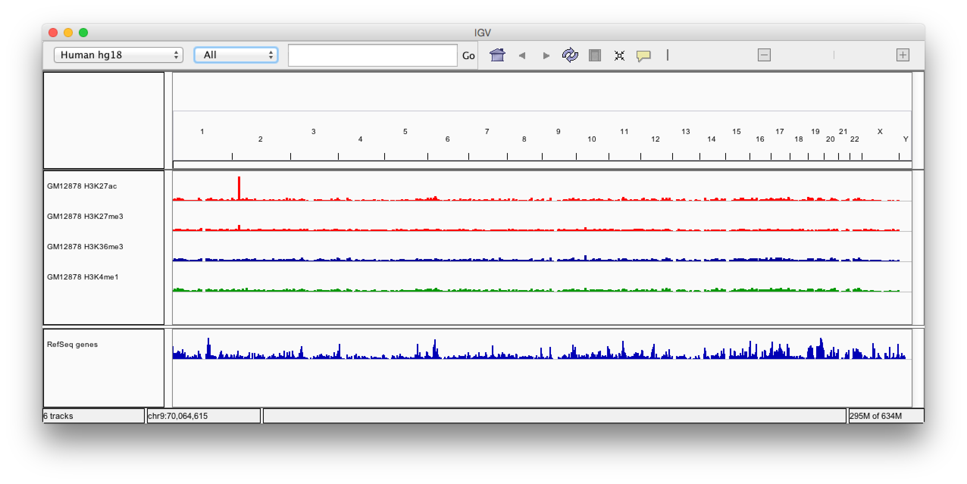




IGV basics
Hands-on exercise
Whole genome

Slide 12
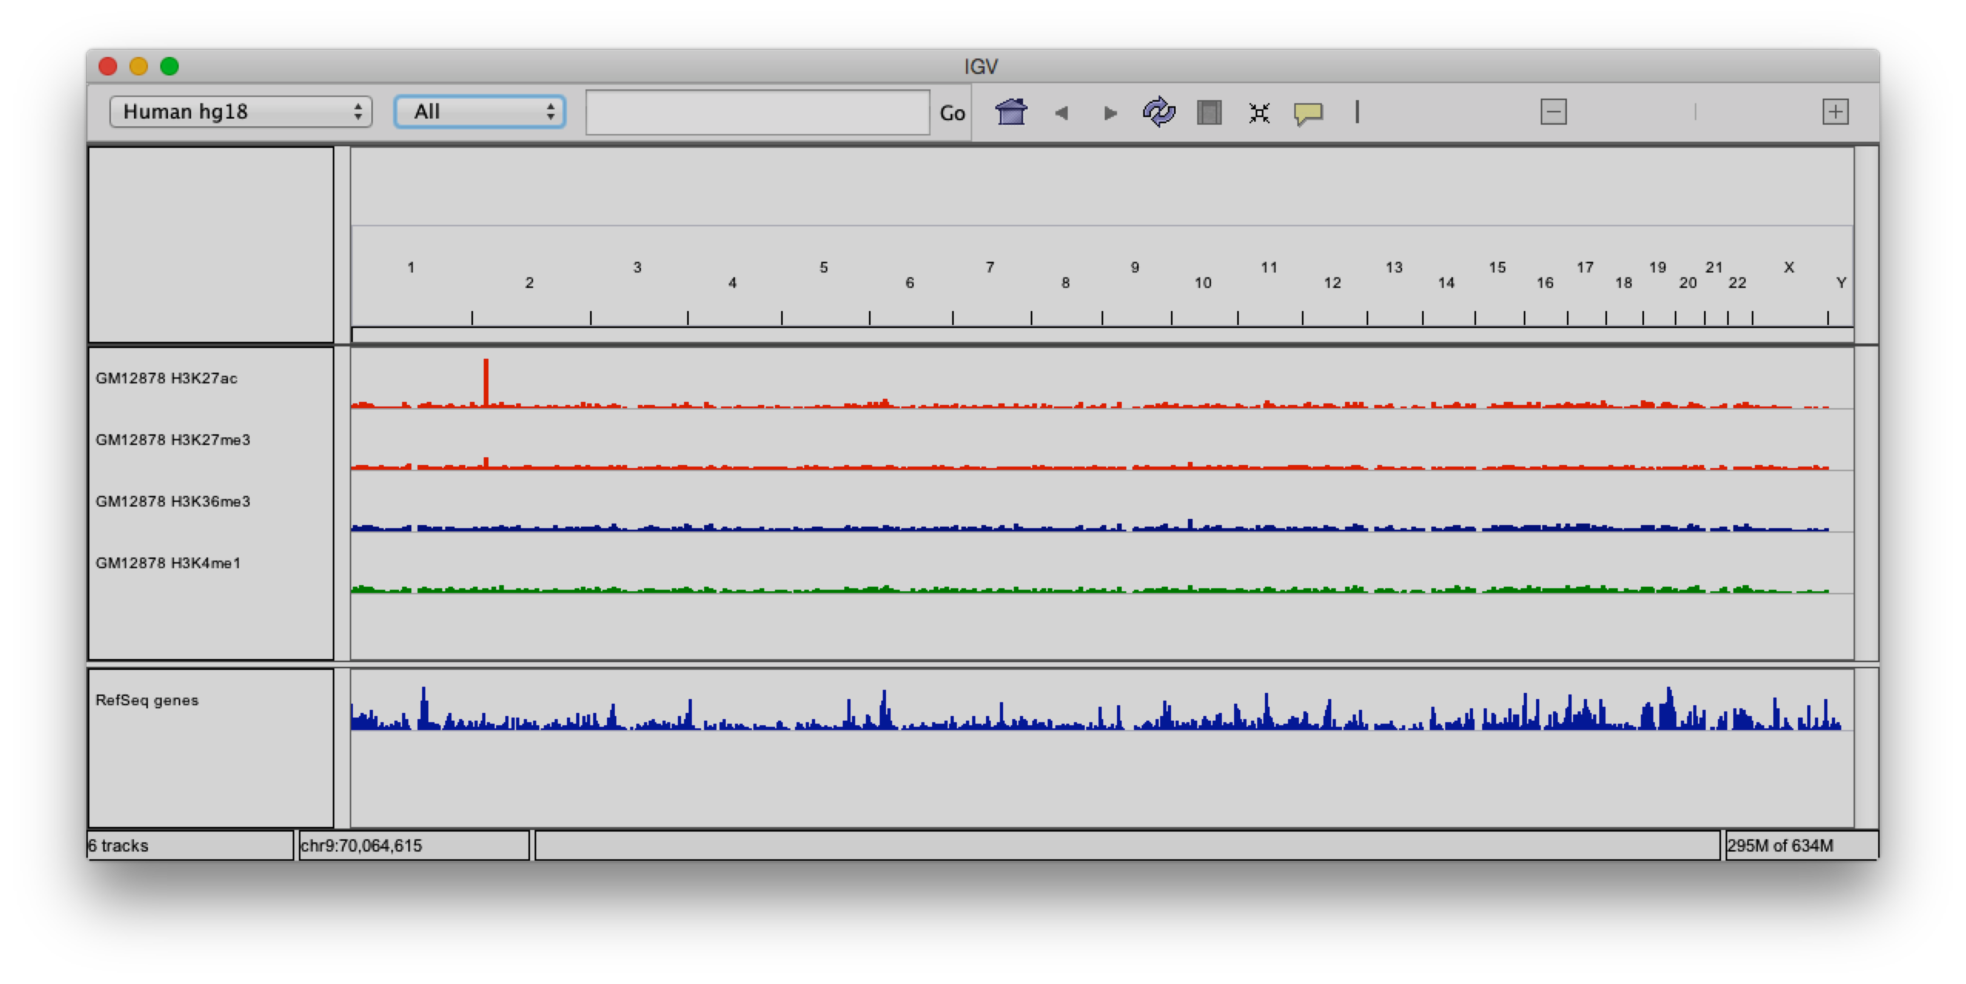
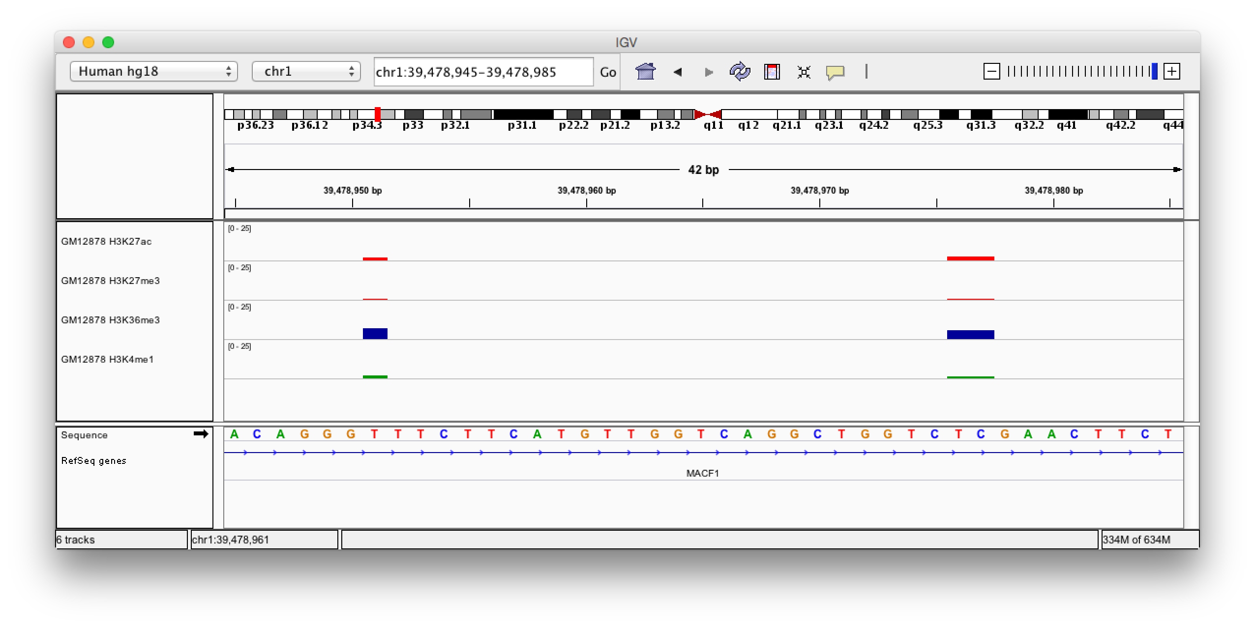




IGV basics
Hands-on exercise
Whole genome
Base pair resolution

Slide 13

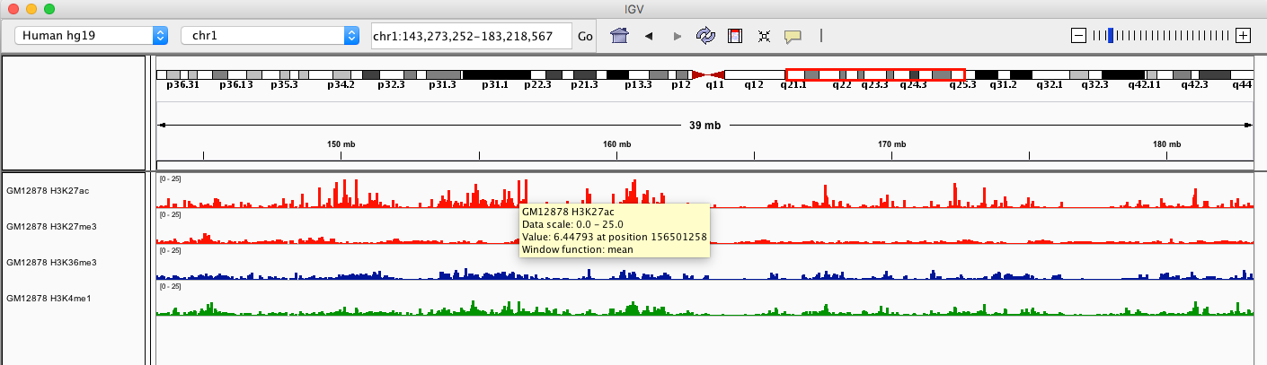

More basics – data details popup
By default, a yellow “data detail” window pops up as the cursor hovers over a data element in a track

Slide 14
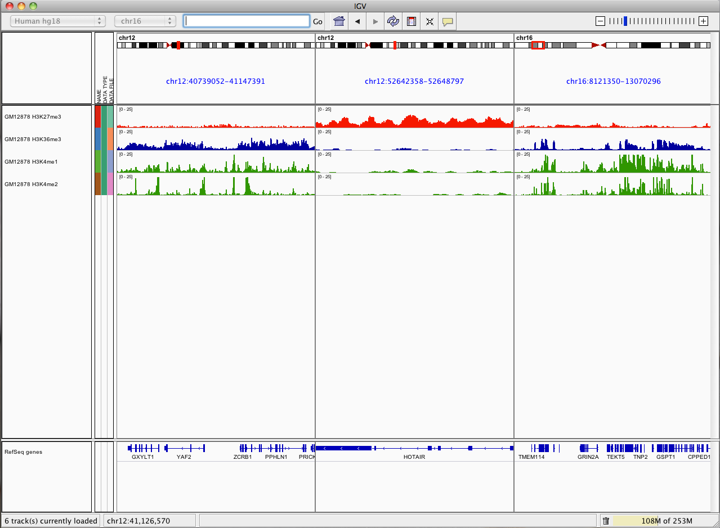



Viewing multiple regions
Multi-Locus or Split-Screen view
Locus 1
Locus 2
Locus 3

Slide 15
more about loading
Reference Genomes

Slide 16
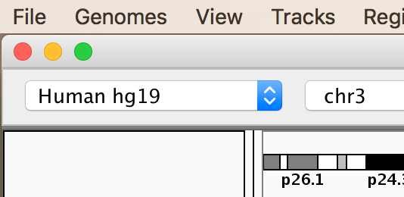

Genome menu
The genome drop-down menu is in the upper left corner of the IGV window.
The genome menu is short when you first install IGV.
But IGV hosts dozens of genomes and you can load other genomes too.

Slide 17
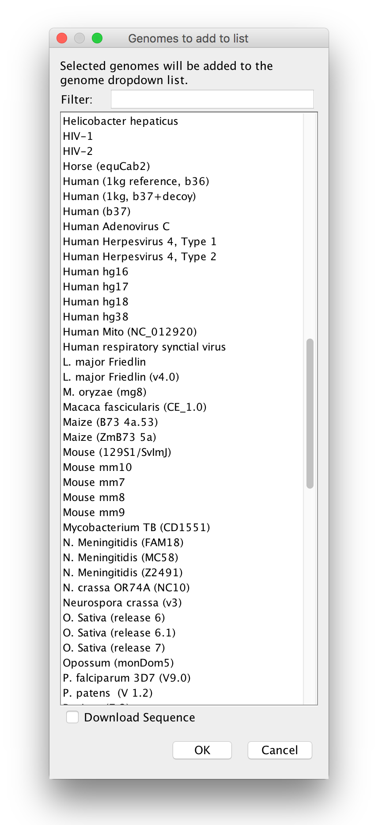
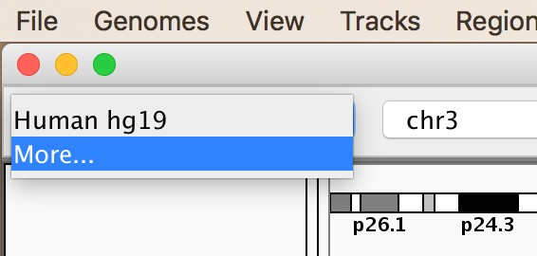


More hosted genomes
To get more genomes from the IGV server:
(1) Select More from the genome menu to see the complete list

Slide 18
Viewing Next Generation Sequencing (NGS) Data

Slide 19
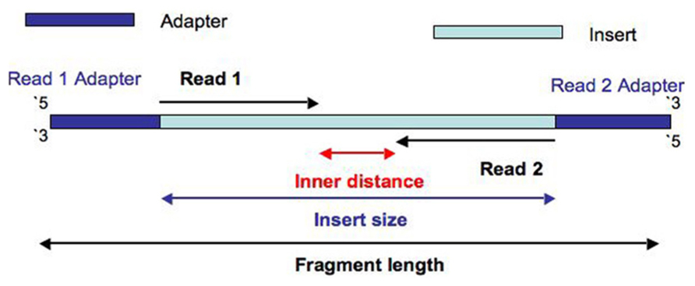
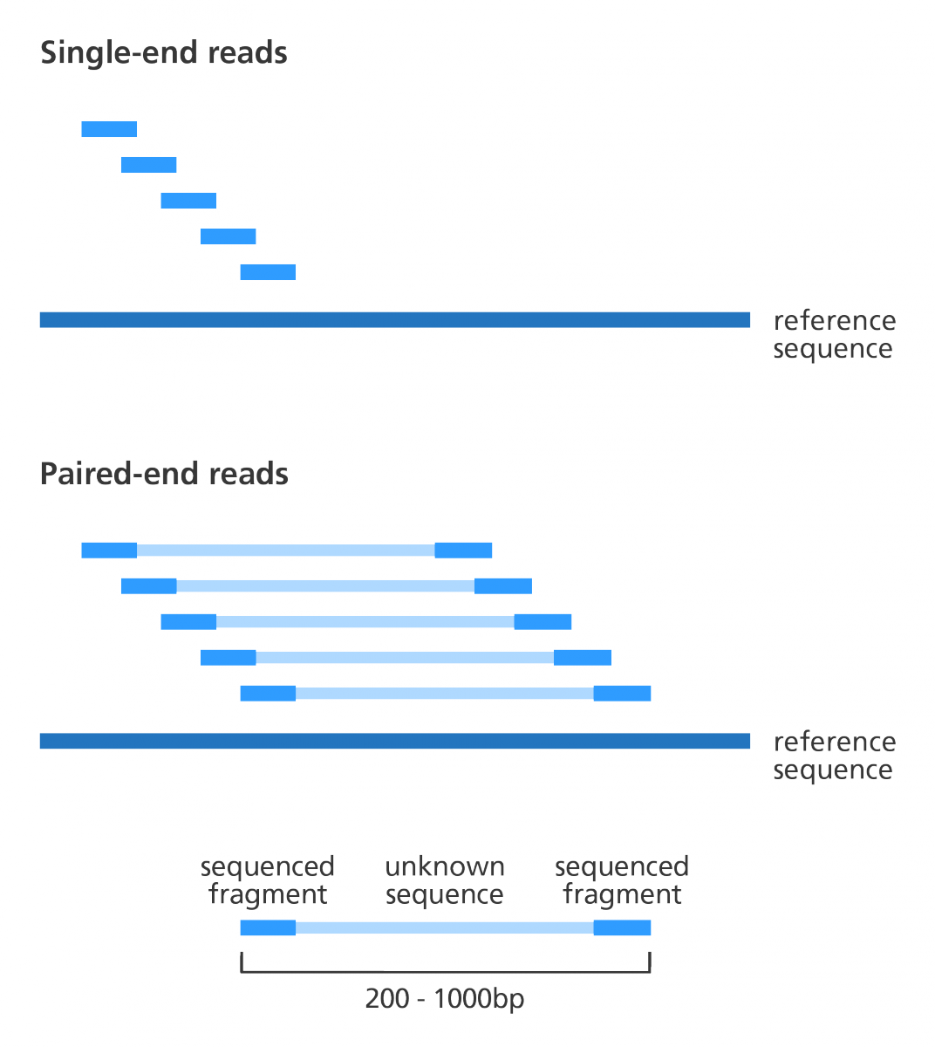
NGS sequencing

Slide 20
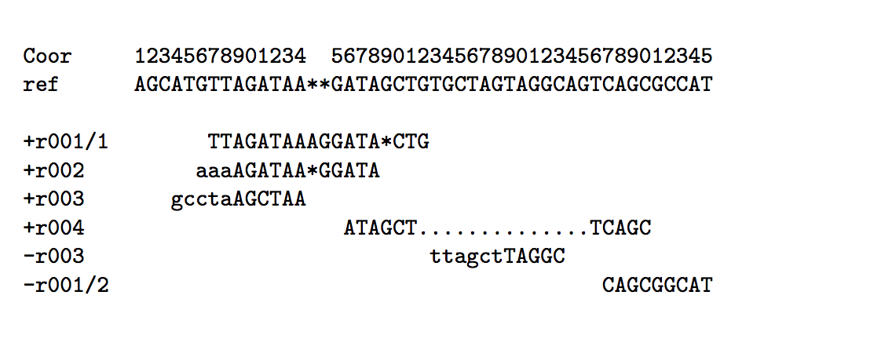
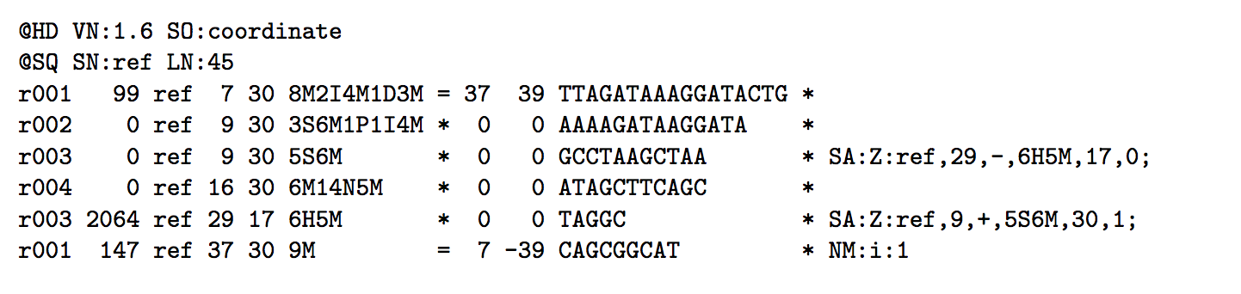
SAM/BAM (Sequence Alignment Map/Binary Alignment Map)
Example:
10
20
30
40
Corresponding SAM:
Header (here: how the sorting order has been made
Reference seq
Alignment
section
Mapping quality
Paired reads info
Read name
Position in ref
Cigar string
Sequence quality of each bp (* if absent)

Slide 21
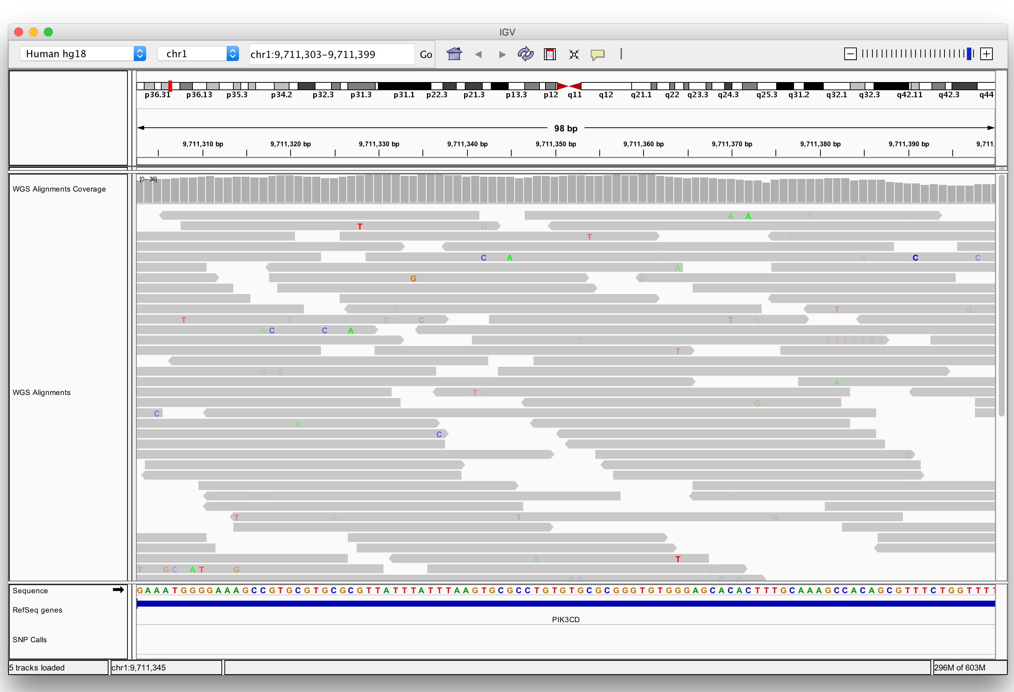
Viewing alignments

Slide 22
Viewing alignments

Slide 23
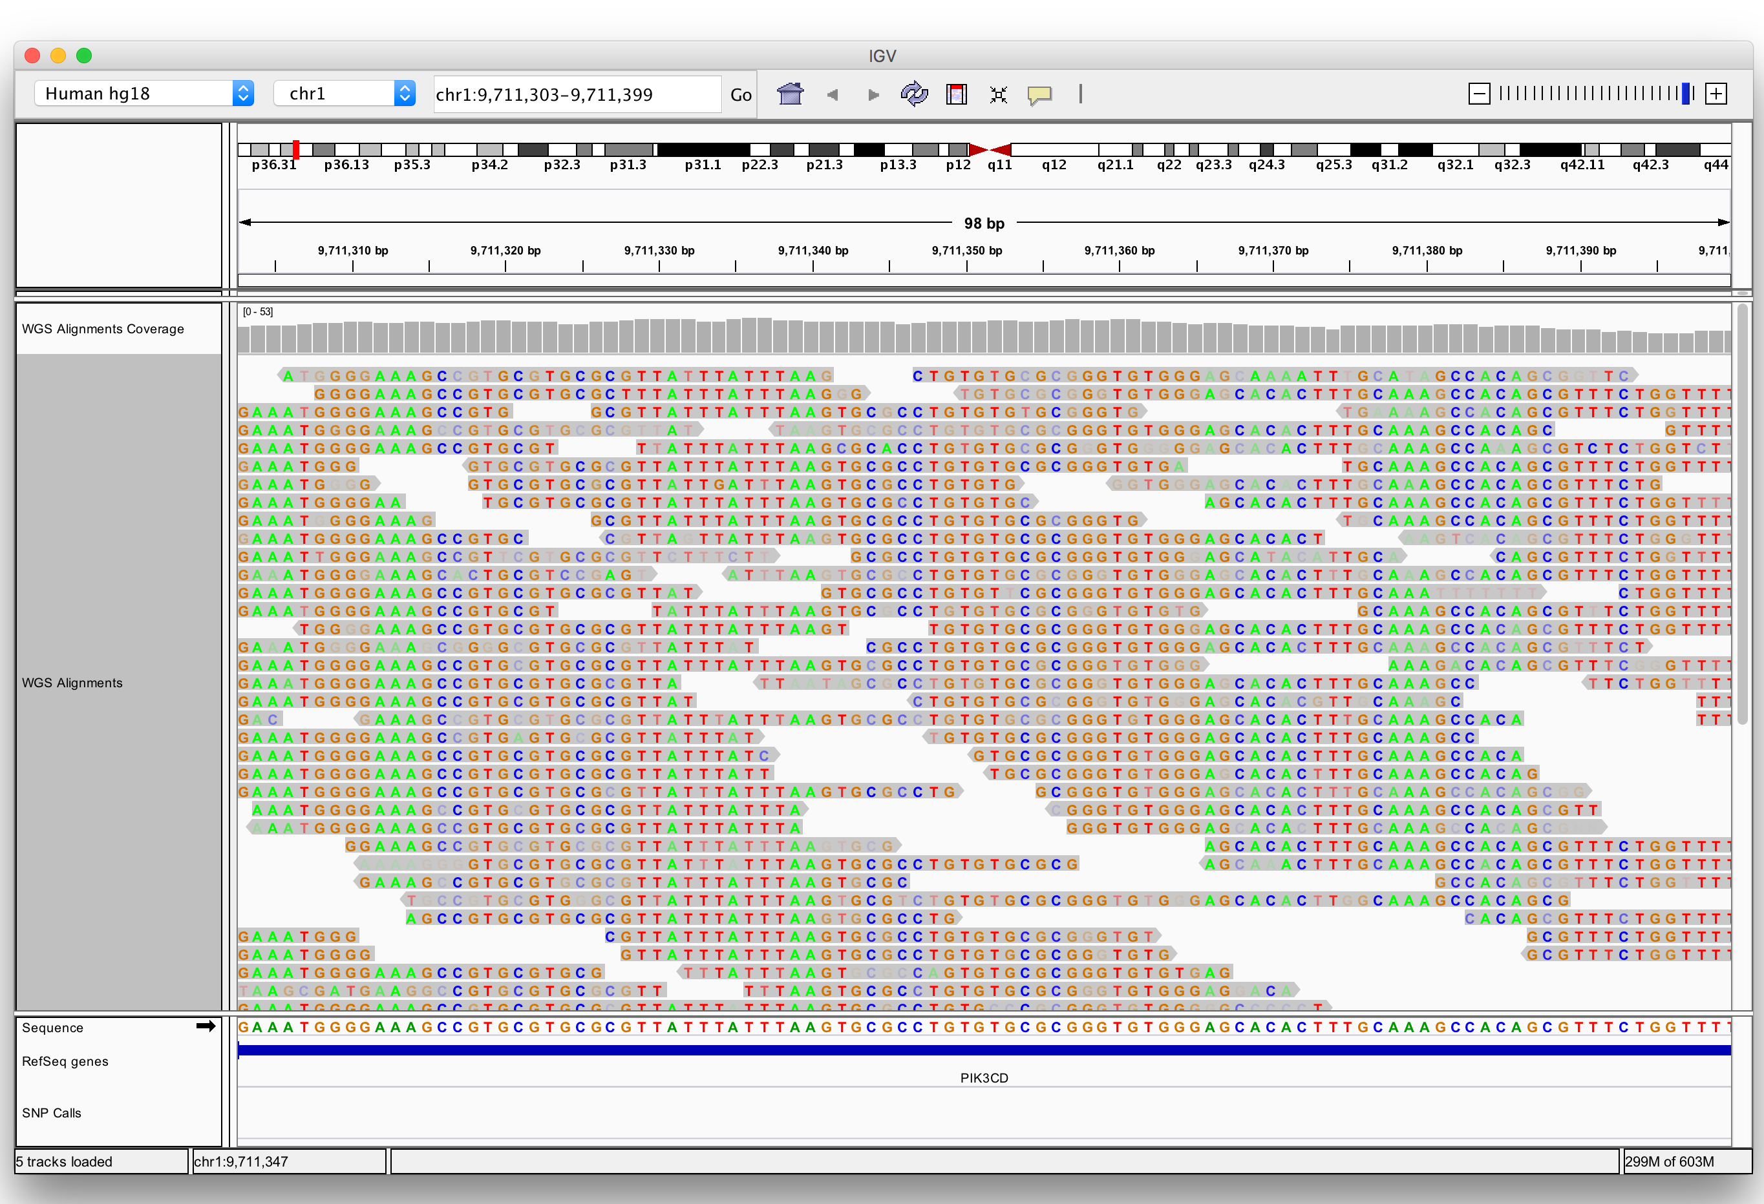
Viewing alignments

Slide 24
Viewing alignments

Slide 25
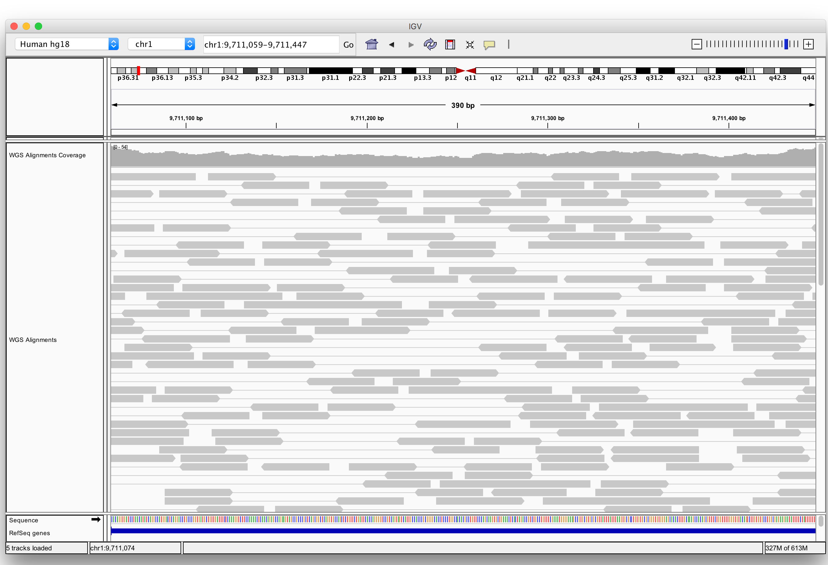
Viewing alignments

Slide 26
Viewing alignments

Slide 27
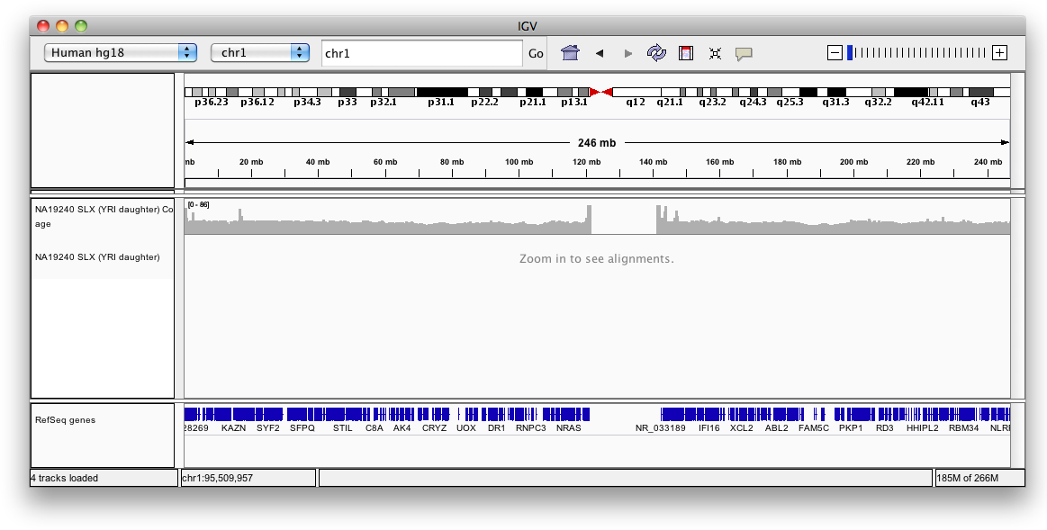


Viewing alignments
Whole chromosome view
Coverage
Zoom in to see alignments

Slide 28
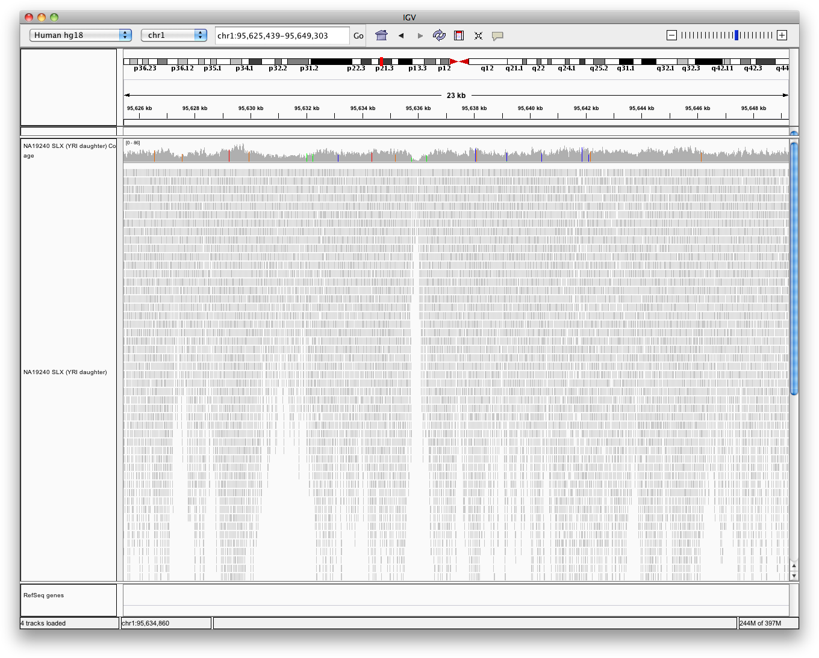

Viewing alignments
Zoom in to view alignments
Coverage
Aligned reads

Slide 29
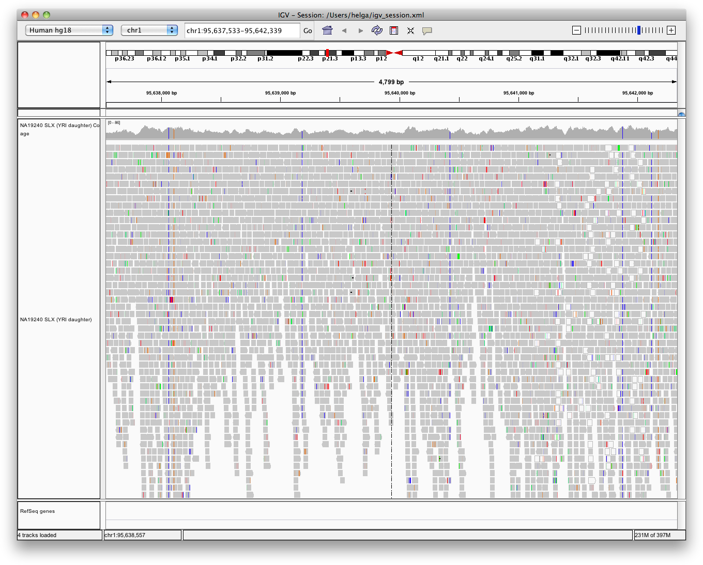

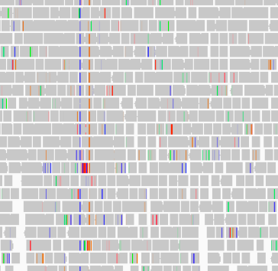
Viewing alignments
Zoom in to see more detail
Bases that do not match the reference sequence are highlighted by color

Slide 30



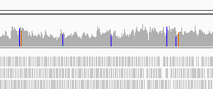
Viewing alignments
Coverage track indicates loci with large number of mismatches

Slide 31
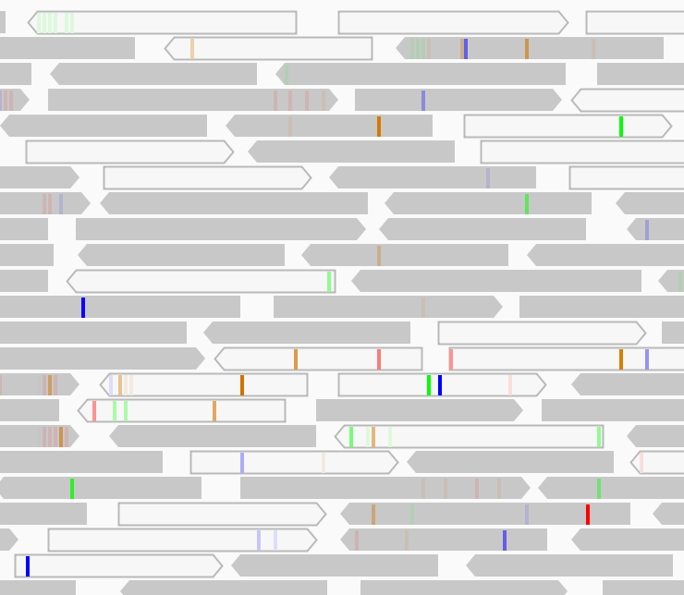

Viewing alignments
Mapping quality
Read mapping q
uality = 0

Slide 32
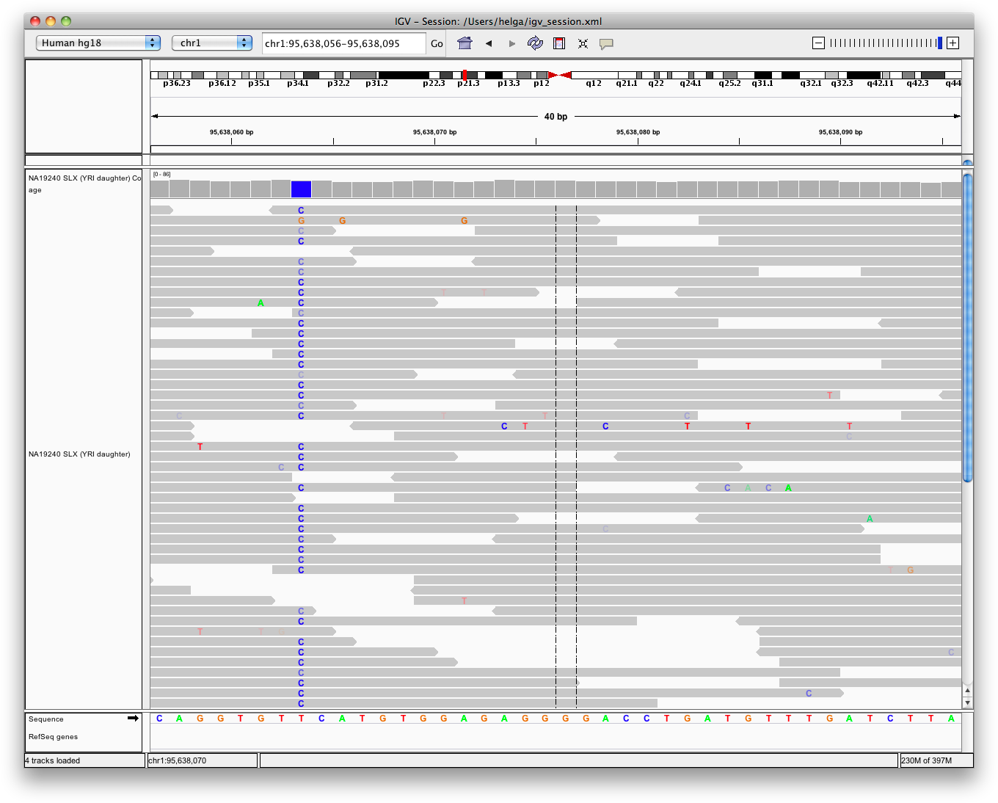


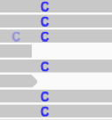
Viewing alignments
Sequence quality
Zoom in to see more detail
Low-quality base calls are faint, semi-transparent.

Slide 33
Viewing SNPs
Hands-on exercise
Load alignments from whole genome sequencing
View sites where SNPs were called
Sort and color to highlight patterns
See Handout – Viewing SNPs

Slide 34
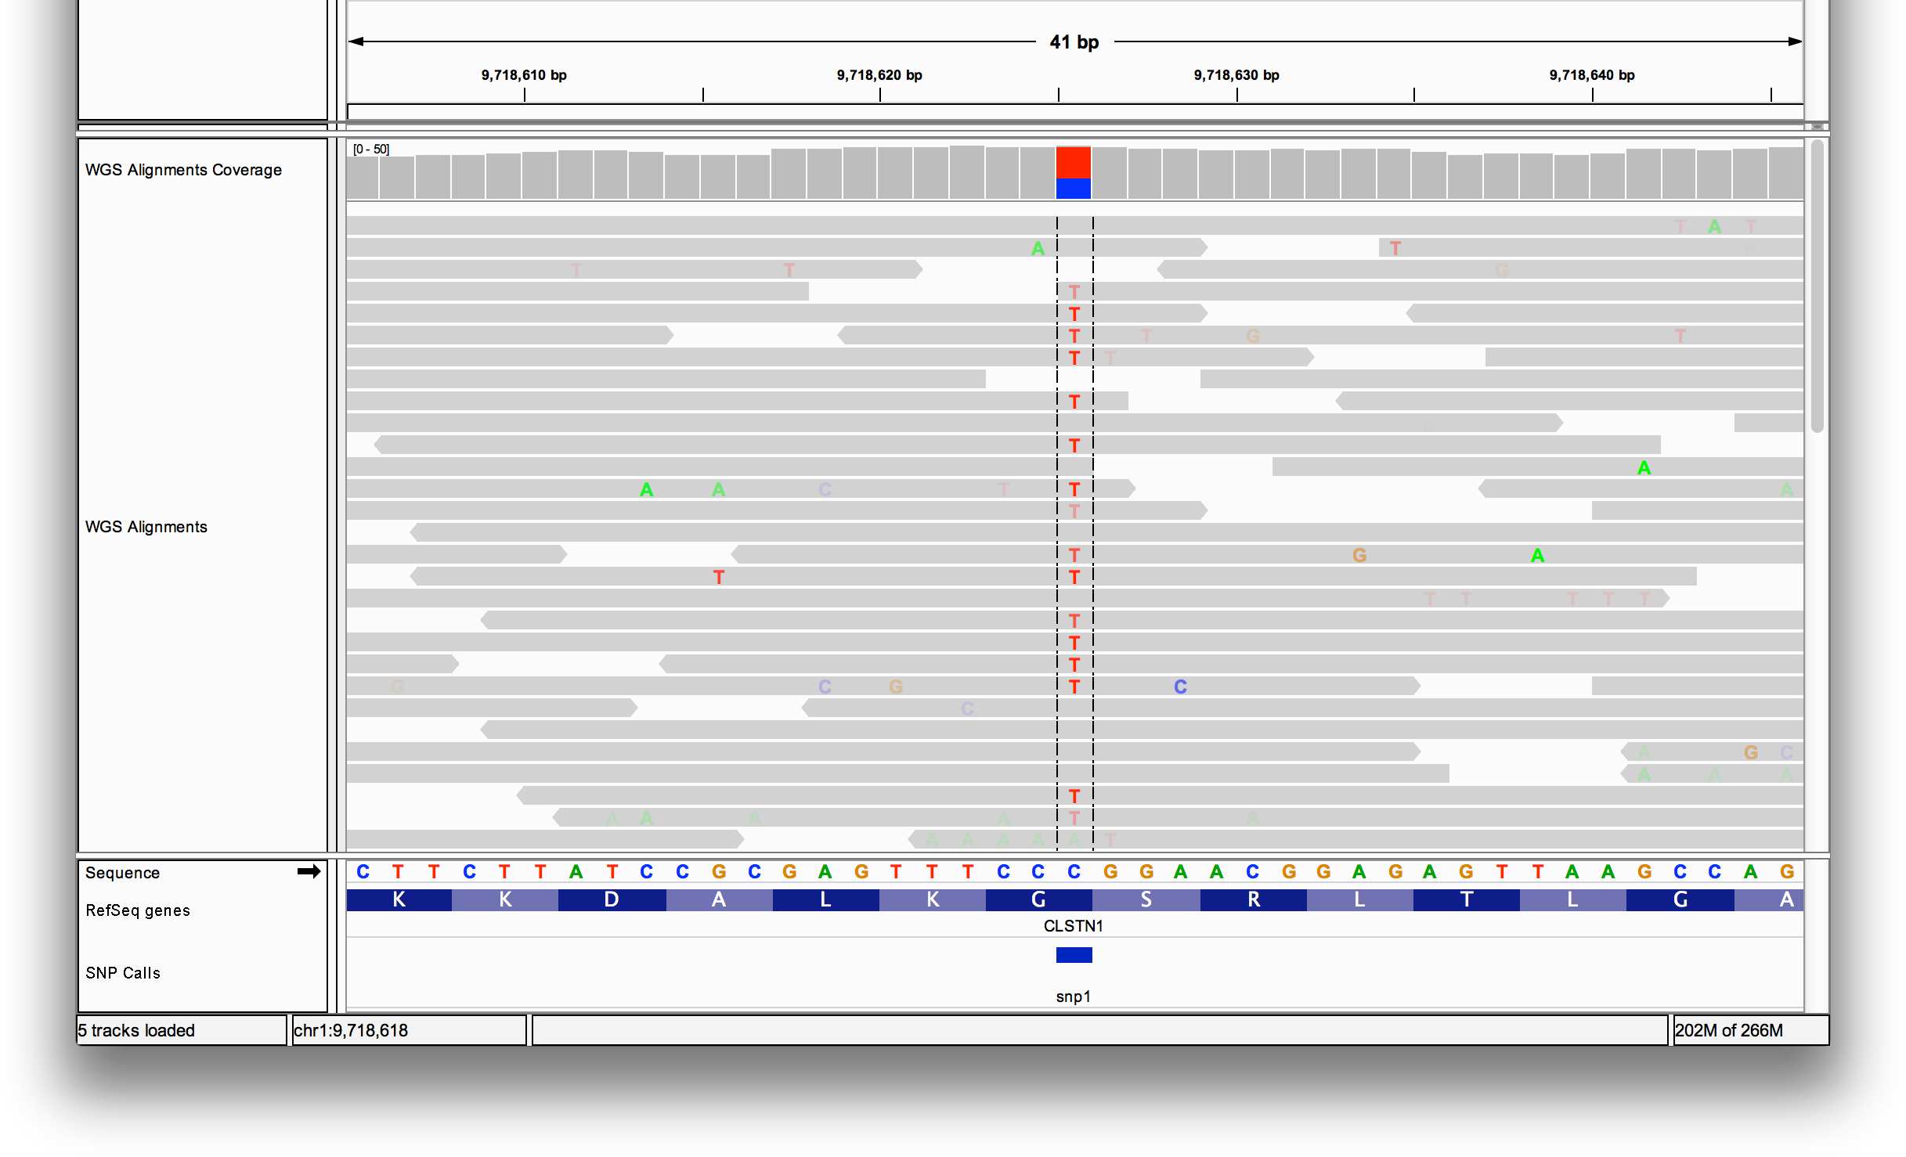
Viewing SNPs
Hands-on exercise

Slide 35
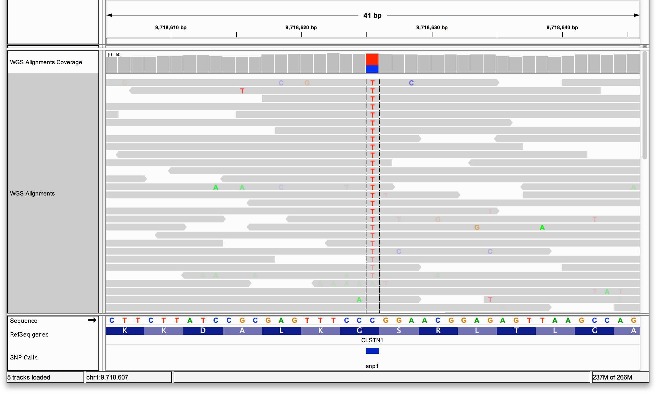
Viewing SNPs
Hands-on exercise

Slide 36

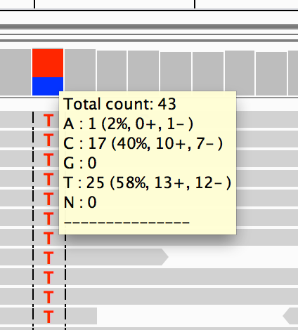



Viewing SNPs
Hands-on exercise
Mouse over red & blue bar in coverage track. Note allele counts and frequencies.

Slide 37
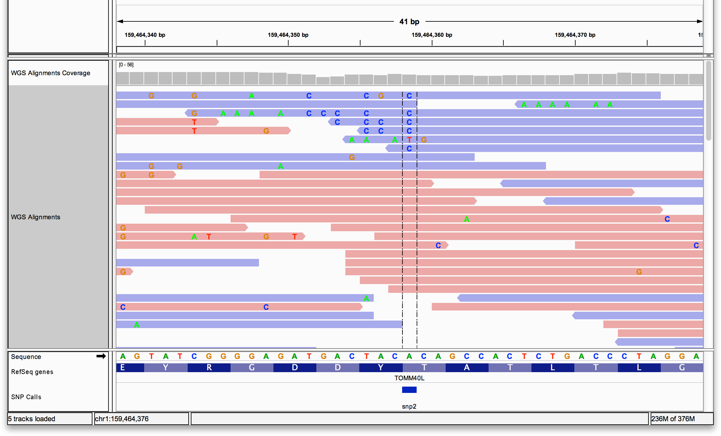
Viewing SNPs
Hands-on exercise

Slide 38
Viewing RNA-seq Data

Slide 39
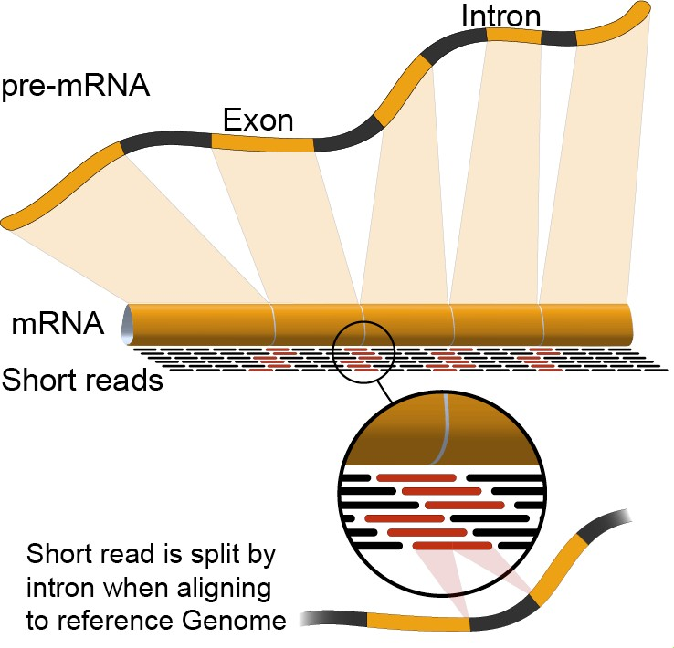
RNA-seq
http://en.wikipedia.org/wiki/RNA-Seq#Gene_expression

Slide 40
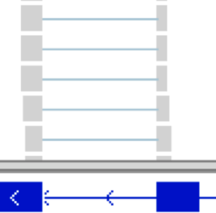
RNA-seq
IGV

Slide 41
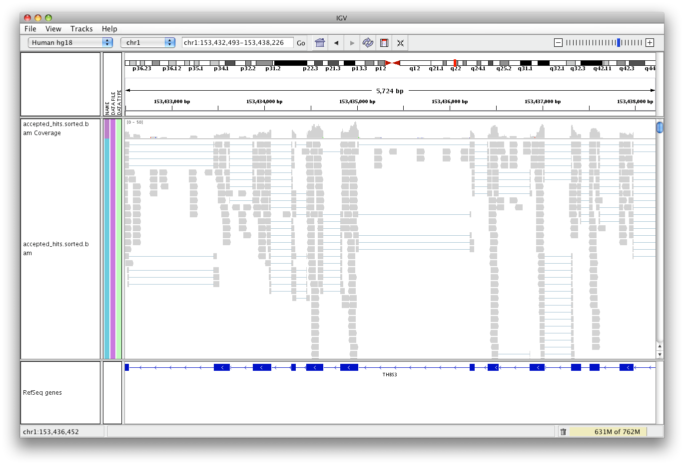


RNA-seq alignments
Read spanning splice junction

Slide 42
RNA-seq alignments
Splice junction track
Example: hg19, SLC25A3

Slide 43


RNA-seq alignments
Splice junction track
Arcs represent reads that span exon junctions

Slide 44

RNA-seq alignments
Splice junction track
Height is proportional to number of reads

Slide 45

RNA-seq alignments
Splice junction track
Many reads connecting these exons

Slide 46

RNA-seq alignments
Splice junction track
Relatively few spanning to this exon

Slide 47
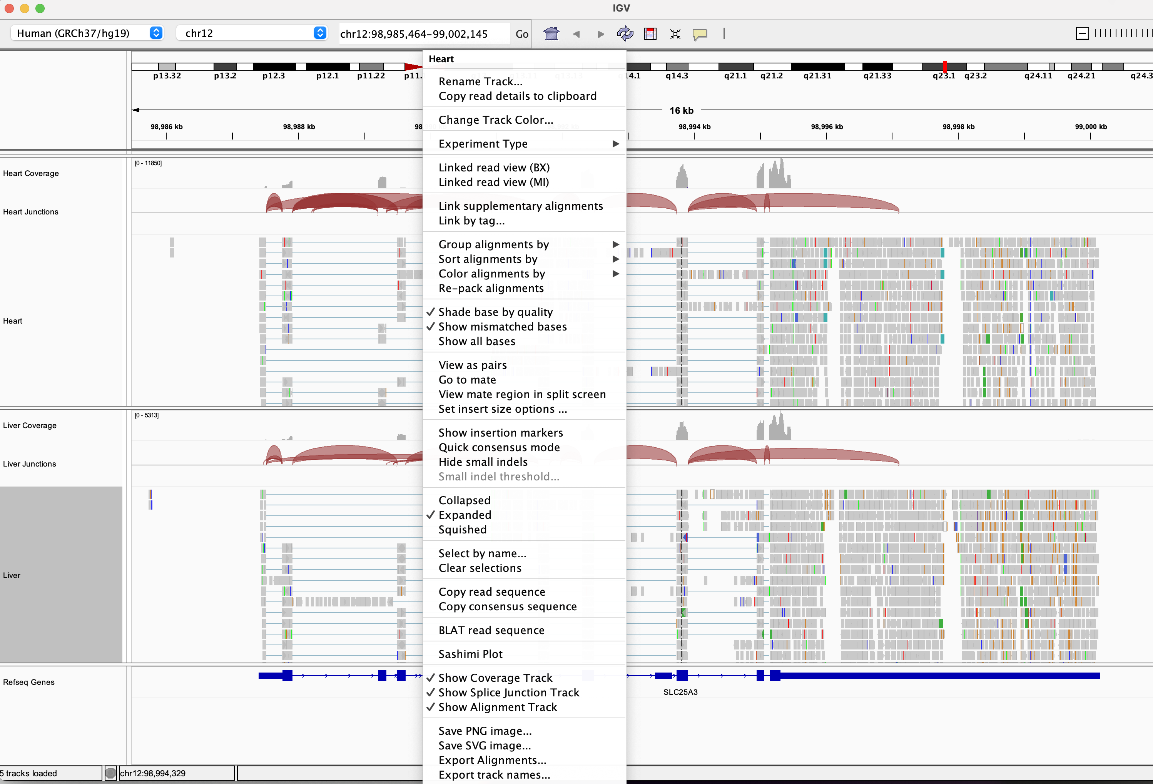

Enabling Splice Junction track
Junction track can be enabled from the right-click menu on the alignment
Select Show Splice Junction Track

Slide 48
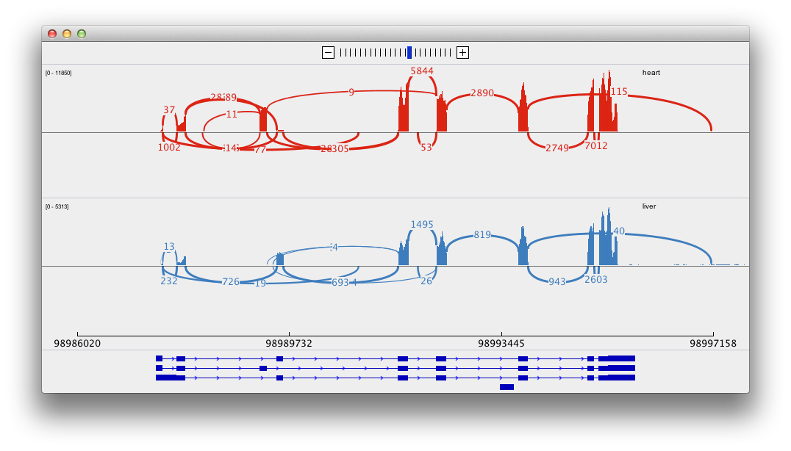
RNA-seq alignments
Sashimi Plot

Slide 49
RNA-seq alignments
Sashimi Plot
Arcs represent reads that span exon junctions

Slide 50

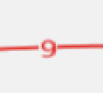

RNA-seq alignments
Sashimi Plot
Numbers are read counts

Slide 51





RNA-seq alignments
Sashimi Plot
Peaks represent coverage within exon

Slide 52
Viewing RNA-seq data
Hands-on exercise
Examine tissue-specific alternative splicing.
Data: Illumina BodyMap 2.0
See handout – Viewing RNA-Seq Data

Slide 53
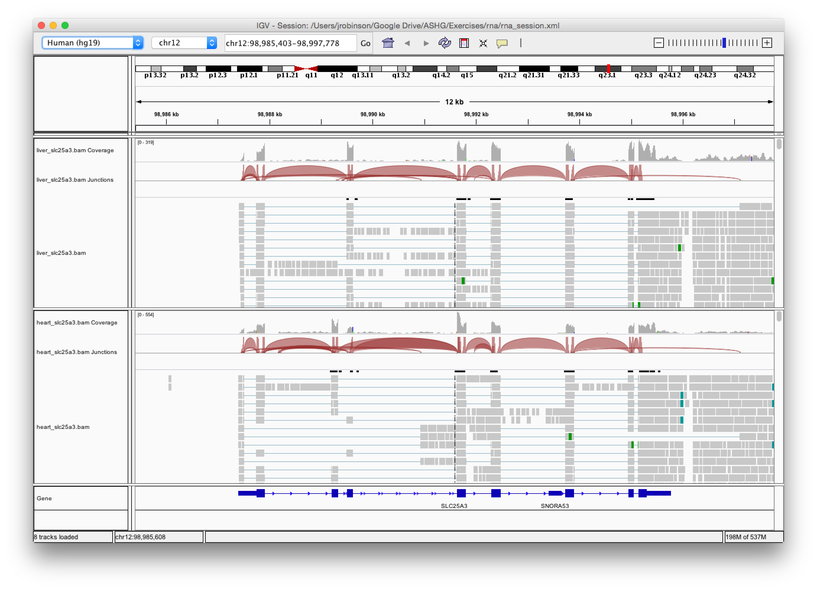
Viewing RNA-seq data
Hands-on exercise
Liver
Heart

Slide 54
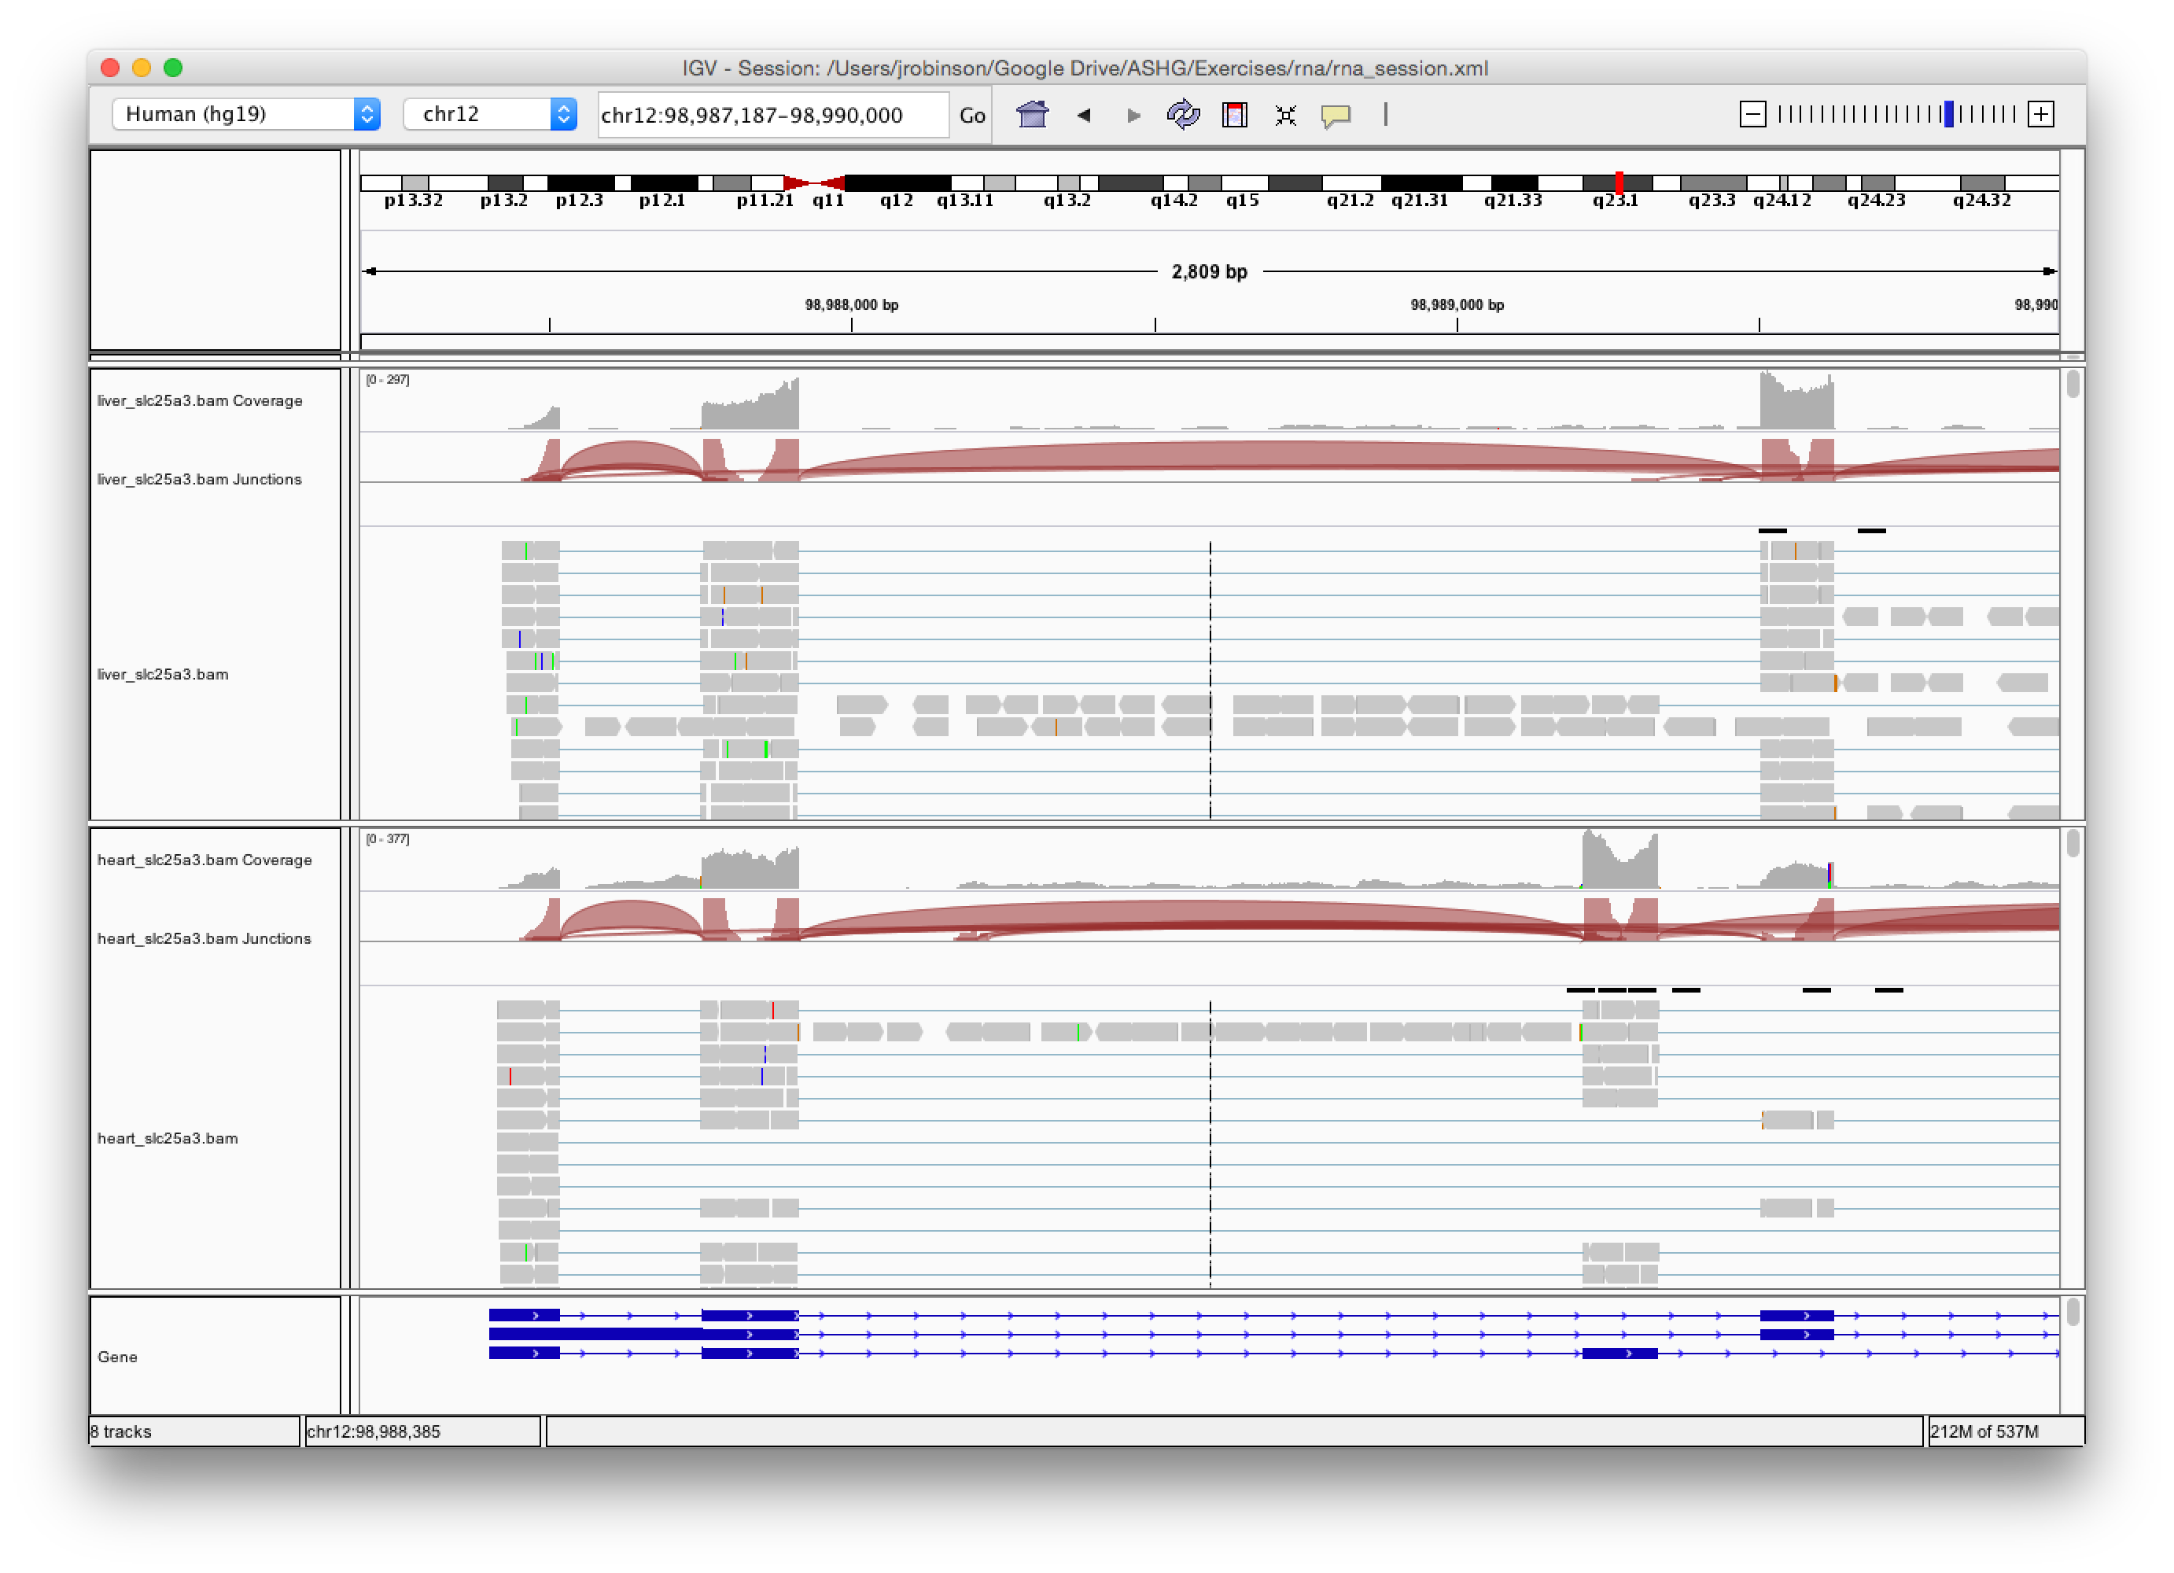



Viewing RNA-seq data
Hands-on exercise
Evidence of alternative splicing

Slide 55
Viewing RNA-seq data
Hands-on exercise
Launch Sashimi Plot
from the popup menu

Slide 56
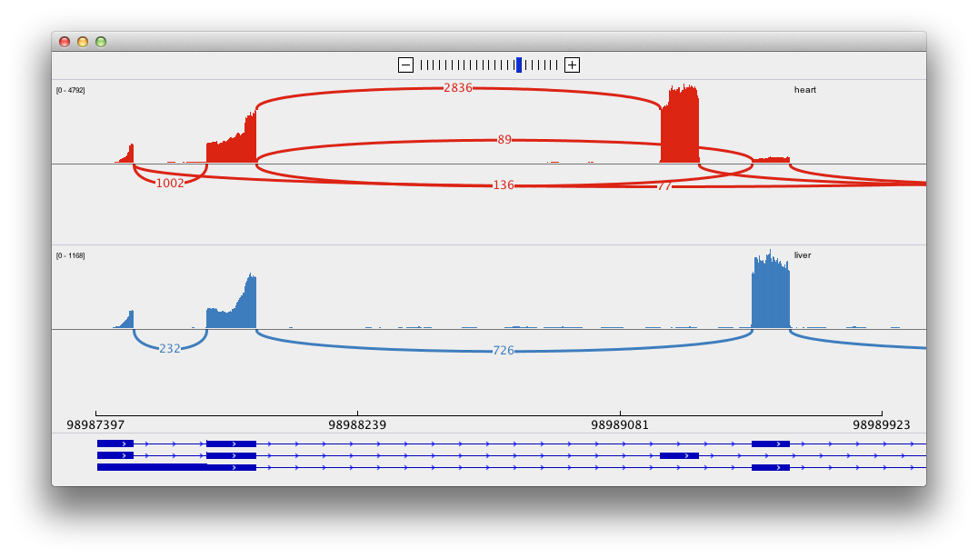
Viewing RNA-seq data
Hands-on exercise
Filter and zoom in on the first few exons

Slide 57
Viewing Structural Events

Slide 58
Structural events
Structural events include deletions, duplications, translocations, and inversions.
Paired reads can yield evidence of structural events.
Alignment coloring options help highlight these events based on:
Inferred insert size (template length)
Pair orientation (relative strand of pair)

Slide 59
Paired-end sequencing
DNA or cDNA
fragment
read from each end
align to reference

Slide 60








Paired-end sequencing
DNA or cDNA
fragment
read from each end
align to reference
F
R

Slide 61







Paired-end sequencing
DNA or cDNA
fragment
read from each end
align to reference
F
R
F
R
F
R

Slide 62


Paired-end sequencing
DNA or cDNA
fragment
read from each end
insert size (or template length)
align to
reference
inferred insert size (or observed template length)

Slide 63


Deletion
A
B
reference genome
A
B
subject

Slide 64
Deletion
A
B
reference genome
A B
subject

Slide 65



Deletion
A
B
reference genome
A B
subject

Slide 66

Deletion
A
B
reference genome
A B
subject

Slide 67


Deletion
A
B
reference genome
A B
subject

Slide 68

Deletion
A
B
reference genome
A B
subject

Slide 69


Deletion
A
B
reference genome
A B
subject

Slide 70


Deletion
Inferred insert size
reference genome
Expected insert size
subject
Inferred insert size is greater than expected value

Slide 71
Deletion
Pairs with larger than expected insert size are colored red
reference genome
subject

Slide 72
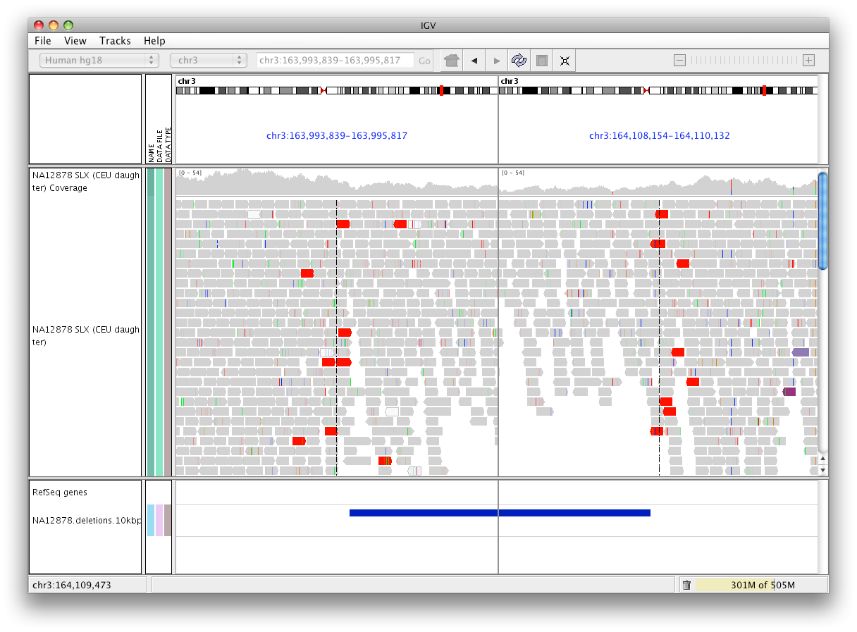
Deletion
Pairs with larger than expected insert size are colored red

Slide 73


Deletion
Note drop in coverage
split screen view

Slide 74







Inter-chromosomal fusion
chr1
chr6
reference genome
subject
chr1
chr6

Slide 75


Inter-chromosomal fusion
chr1
chr6
reference genome
subject
chr1
chr6

Slide 76



Inter-chromosomal fusion
chr1
chr6
reference genome
subject
chr1
chr6

Slide 77






Inter-chromosomal fusion
chr1
chr6
reference genome
subject
chr1
chr6

Slide 78

Inter-chromosomal fusion
chr1
chr6
reference genome
chr 6 color chr 1 color
Each read is colored by the chromosome of its mate
Chromosome colors:

Slide 79
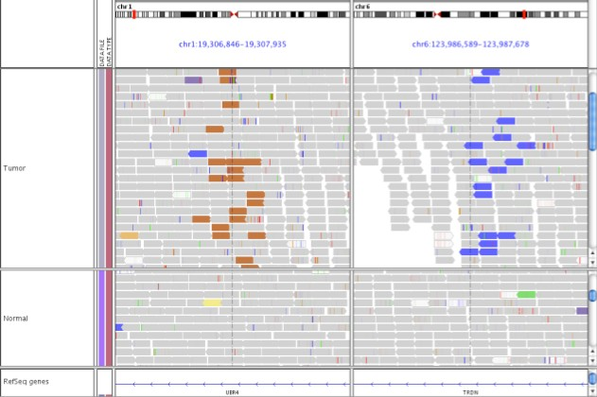



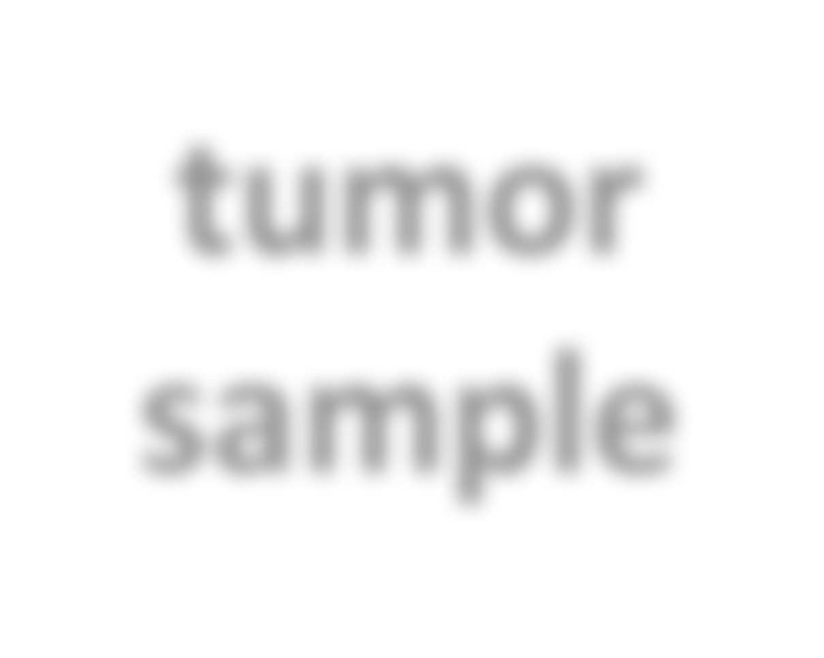




Inter-chromosomal fusion
split screen view
chr 1
chr 6
tumor sample
normal sample

Slide 80
Inter-chromosomal fusion
chr 1
chr 6
Read color indicates mate is on chr 6
Read color indicates mate is on chr 1
tum sam
or
ple
normal sample
No similar evidence in the normal sample

Slide 81






Inversion
A
B
reference genome
B
A
subject

Slide 82



Inversion
A
B
reference genome
B
A
subject

Slide 83


Inversion
A
B
reference genome
B
A
subject

Slide 84

Inversion
A
B
reference genome
B
A
subject

Slide 85


Inversion
A
B
reference genome
B
A
subject

Slide 86




Inversion
A
B
reference genome
forward
forward
B
A
subject

Slide 87
Inversion
A
B
reference genome
B
A
subject

Slide 88












Inversion
A
B
reference genome
reverse
reverse
B
A
subject

Slide 89
Inversion
A
B
reference genome
B
A
subject

Slide 90
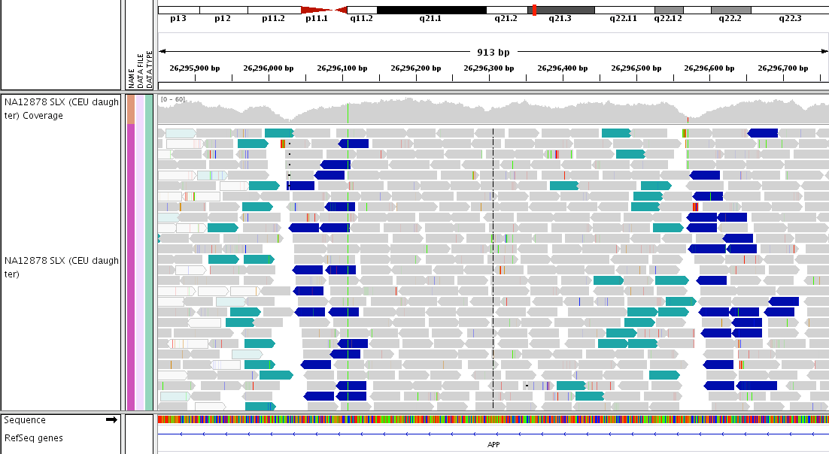
Inversion

Slide 91


Inversion
Note drop in coverage at breakpoints

Slide 92


Inversion
Right-click on the alignments and select
View as pairs

Slide 93

Inversion
Hands-on exercise

Slide 94
Viewing Variants

Slide 95
Variant Call Format (VCF):
File format for encoding variant sites and genotypes
The VCF specification is now maintained by the
Global Alliance for Genomics and Health (GA4GH)
à Data Working Group à File Formats Task Team
(http://ga4gh.org/#/fileformats-team)

Slide 96

VCF (Variant Call Format)
Metainformation
Header line
Data

Slide 97

Viewing variants (VCF file)

Slide 98

Viewing variants (VCF file)
Variant sites
Sample information
Genotypes

Slide 99
Viewing variants (VCF file)

Slide 100


Viewing variants (VCF file)
Zoom in here

Slide 101

Viewing variants (VCF file)
Red = alternate allele Blue = reference allele

Slide 102


Viewing variants (VCF file)

Slide 103
Viewing variants (VCF file)
 | Cyan = Blue = Grey = | homozygous heterozygous reference

Slide 104


Viewing variants (VCF file)

Slide 105


Viewing variants – sample information
Sample information
Meta data on samples.
Used for sorting & grouping
In this example:
sample
pop
super_pop
gender

Slide 106




Viewing variants – sample information
Sample information is defined in an auxiliary tab-delimited file.
First row defines the meta data column names
First column contains sample names (must match VCF sample names)
Example:
Meta data column names
VCF sample names

Slide 107
Viewing variants (VCF file)
Hands-on exercise
Use sample information to examine a variant that segregates by population.
Reference:
Giulio Genovese et al.
Association of Trypanolytic ApoL1 Variants with Kidney Disease in African Americans,
Science 329, 841 (2010); DOI: 10.1126/science.1193032
See handout – Viewing Variants (VCF file)

Slide 108
Viewing variants (VCF file)
Hands-on exercise

Slide 109

Viewing variants (VCF file)
Hands-on exercise
APOL1: S342G
In the search box enter
APOL1:S342G and click Go
Right-click over genotypes and select
Display Mode > Squished
Right-click over genotypes and select
Group By, and then attribute super_pop

Slide 110

Viewing variants (VCF file)
Hands-on exercise

Slide 111

BLAT
Use a BLAT server to do search for alternative alignments for
o any feature or sequence read, or
o user-entered sequence.
User-specified server or
UCSC (volume limits apply).

Slide 112

BLAT example

Slide 113
BLAT example
Investigate this peak

Slide 114


BLAT example
Investigate this peak

Slide 115



BLAT example
Right-click on a read and select BLAT read sequence

Slide 116

BLAT example

Slide 117

BLAT example
Many alternative alignments with similar scores

